Slide 1

Part 5 Chapter 13
Marketing: Developing Relationships
© 2016 by McGraw-Hill Education. This is proprietary material solely for authorized instructor use. Not authorized for sale or distribution in any manner. This document may not be copied, scanned, duplicated, forwarded, distributed, or posted on a website, in whole or part.
Notes:
We continue part 5 of your textbook, Marketing: Developing Relationships, with chapter 13, Digital Marketing and Social Networking

Slide 2
CHAPTER 11
Customer-Driven Marketing
CHAPTER 12
Dimensions of Marketing Strategy
CHAPTER 13
Digital Marketing and Social Networking
Notes:
In chapter 13 we discuss using digital media in business and marketing. In this chapter, we first provide some key definitions related to digital marketing and social networking. Next, we discuss using digital media in business and digital marketing. We look at marketing mix considerations when using digital media and pay special attention to social networking. Then we focus on digital marketing strategies—particularly new communication channels like social networks— and consider how consumers are changing their information searches and consumption behavior to fi t emerging technologies and trends. Finally, we examine the legal and social issues associated with information technology, digital media, and e-business.

Slide 3
Learning Objectives
LO 13-1 Define digital media and digital marketing and recognize their increasing value in strategic planning.
LO 13-2 Demonstrate the role of digital marketing and social networking in today’s business environment.
LO 13-3 Show how digital media affects the marketing mix.
LO 13-4 Define social networking and illustrate how businesses can use different types of social networking media.
LO 13-5 Identify legal and ethical considerations in digital media.
LO 13-6 Evaluate a marketer’s dilemma and propose recommendations.
Notes:
After reading this chapter, you will be able to:
Define digital media and digital marketing and recognize their increasing value in strategic planning.
Demonstrate the role of digital marketing and social networking in today’s business environment.
Show how digital media affect the marketing mix.
Define social networking and illustrate how businesses can use different types of social networking media.
Identify legal and ethical considerations in digital media.
Evaluate a marketer’s dilemma and propose recommendations.

Slide 4
E-Business, Digital Media, and Digital Marketing
E-Business
Carrying out the goals of business through utilization of the Internet
Digital Media
Electronic media that function using digital codes via computers, cellular phones, smart phones, and other digital devices that have been released in recent years
Digital Marketing
Uses all digital media, including the Internet and mobile and interactive channels, to develop communication and exchanges with customers
Notes:
Let’s start with a clear understanding of our focus in this chapter. First, we can distinguish e-business from traditional business by noting that conducting e-business means carrying out the goals of business through the use of the Internet. Digital media are electronic media that function using digital codes—when we refer to digital media, we mean media available via computers and other digital devices, including mobile and wireless ones like smartphones.
Digital marketing uses all digital media, including the Internet and mobile and interactive channels, to develop communication and exchanges with customers. Digital marketing is a term we will use often, because we are interested in all types of digital communications, regardless of the electronic channel that transmits the data. Digital marketing goes beyond the Internet and includes mobile phones, banner ads, digital outdoor marketing, and social networks.

Slide 5
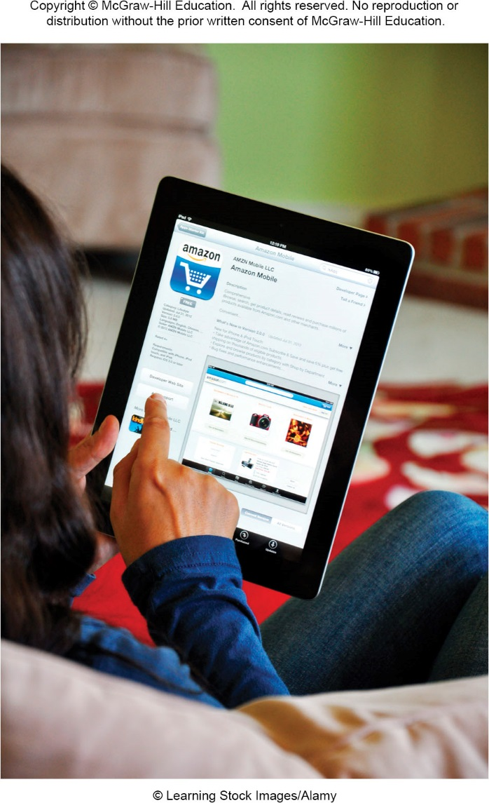
Amazon’s Mobile Applications
Amazon’s mobile applications make it easier for users to shop and purchase items on the go
One of the most successful electronic businesses
Amazon.com is ranked 49 on the Fortune 500 list of America’s largest corporations
A true digital marketer
Gets 40% of its revenue from international sales
Notes:
Consider that Amazon.com, one of the most successful electronic businesses, ranked number 49 on the Fortune 500 list of America’s largest corporations. Amazon is a true digital marketer, getting 40 percent of its revenue from international sales. Many of you may not remember a world before Amazon because it has completely transformed how many people shop.

Slide 6
Growth and Benefits of Digital Communication
Forge relationships with consumers and business customers
Target markets more precisely
Reach previously inaccessible markets at home and around the world
Facilitates business transactions allowing companies to better network
Notes:
The Internet has created tremendous opportunities for businesses to forge relationships with consumers and business customers, target markets more precisely, and even reach previously inaccessible markets at home and around the world. The Internet also facilitates business transactions, allowing companies to network with manufacturers, wholesalers, retailers, suppliers, and outsource firms to serve customers more quickly and more efficiently. The telecommunication opportunities created by the Internet have set the stage for digital marketing’s development and growth.

Slide 7
Characteristics of Digital Marketing (1 of 2)
Addressability
The ability of the marketer to identify customers before they make a purchase
Interactivity
The ability of customers to express their needs and wants directly to the firm in response to its marketing communications
Accessibility
The ability for marketers to obtain digital information
Notes:
Digital communication offers a completely new dimension in connecting with others. Some of the characteristics that distinguish digital from traditional communication are addressability, interactivity, accessibility, connectivity, and control. These terms are discussed in the table on this slide:
Characteristic Definition Example
Addressability The ability of the marketer to identify customers before they make a purchase Amazon installs cookies on a user’s computer that allows it to identify the owner when he or she returns to the website.
Interactivity The ability of customers to express their needs and wants directly to the firm in response to its marketing communications Texas Instruments interacts with its customers on its Facebook page by answering concerns and posting updates.
Accessibility The ability for marketers to obtain digital information Google can use web searches done through its search engine to learn about customer interests.
Connectivity The ability for consumers to be connected with marketers along with other consumers The Avon Voices website encouraged singers to upload their singing videos, which can then be voted on by other users for the chance to be discovered.
Control The customer’s ability to regulate the information they view as well as the rate and exposure to that information Consumers use Kayak to discover the best travel deals.

Slide 8
Characteristics of Digital Marketing (2 of 2)
Connectivity
The ability for consumers to be connected with marketers along with other consumers
Control
The customer’s ability to regulate the information they view as well as the rate and exposure to that information
Notes:
Digital communication offers a completely new dimension in connecting with others. Some of the characteristics that distinguish digital from traditional communication are addressability, interactivity, accessibility, connectivity, and control. These terms are discussed in the table on this slide:
Characteristic Definition Example
Connectivity The ability for consumers to be connected with marketers along with other consumers The Avon Voices website encouraged singers to upload their singing videos, which can then be voted on by other users for the chance to be discovered.
Control The customer’s ability to regulate the information they view as well as the rate and exposure to that information Consumers use Kayak to discover the best travel deals.

Slide 9
Using Digital Media in Business
Fast and inexpensive communication
More interactive
Easier comparison shopping
Easier to conduct marketing research and advertise
Internet markets are more similar to traditional markets than they are different
Lowers cost of communication
Improved communication within/between businesses
Notes:
The phenomenal growth of digital media has provided new ways of conducting business. Given almost instant communication with precisely defined consumer groups, firms can use real-time exchanges to create and stimulate interactive communication, forge closer relationships, and learn more accurately about consumer and supplier needs. Because it is fast and inexpensive, digital communication is making it easier for businesses to conduct marketing research, provide and obtain price and product information, and advertise, as well as to fulfill their business goals by selling goods and services online.
The reality, however, is that Internet markets are more similar to traditional markets than they are different. Thus, successful digital marketing strategies, like traditional business strategies, focus on creating products that customers need or want, not merely developing a brand name or reducing the costs associated with online transactions. Because the Internet lowers the cost of communication, it can contribute significantly to any industry or activity that depends on the flow of digital information such as entertainment, health care, government services, education, and computer services like software development. Digital media can also improve communication within and between businesses. In the future, most significant gains will come from productivity improvements within businesses. Communication is a key business function, and improving the speed and clarity of communication can help businesses save time and improve employee problem-solving abilities.

Slide 10
Digital Media and the Marketing Mix (1 of 2)
Some key differences between digital and traditional media in the marketing mix:
Communications are richer, faster, and more interactive
Companies can reach target markets more easily, affordably, and quickly
They help marketers utilize new resources in seeking out and communicating with customers
One aspect of the marketing that has not changed with digital media is the importance of achieving the right marketing mix
Notes:
While digital marketing shares some similarities with conventional marketing techniques, a few valuable differences stand out. First, digital media make customer communications faster and interactive. Second, digital media help companies reach new target markets more easily, affordably, and quickly than ever before. Finally, digital media help marketers utilize new resources in seeking out and communicating with customers. One aspect of marketing that has not changed with digital media is the importance of achieving the right marketing mix. Product, distribution, promotion, and pricing are as important as ever for successful online marketing strategies.

Slide 11
Digital Media and the Marketing Mix (2 of 2)
To coordinate activities and communicate with employees, customers, and suppliers, marketers use:
E-mail
Mobile phones
Social networking
Wikis
Media sharing
Blogs
Video conferencing
Notes:
One of the most important benefits of digital marketing is the ability of marketers and customers to easily share information. Many marketers use e-mail, mobile phones, social networking, wikis, video sharing, podcasts, blogs, videoconferencing, and other technologies to coordinate activities and communicate with employees, customers, and suppliers.

Slide 12
Product Considerations
The Digital media connectivity creates opportunities to add services and benefits to products
Some products only available digitally
Businesses can offer more online than in a retail store
Internet can make it easier to learn about and anticipate consumer needs
Fierce competition makes quality product and service offerings more important than ever
Notes:
Like traditional marketers, digital marketers must anticipate consumer needs and preferences, tailor their products and services to meet these needs, and continually upgrade them to remain competitive. The connectivity created by digital media provides the opportunity for adding services and can enhance product benefits. Businesses can often offer more items online than they could in a retail store. The Internet can make it much easier to anticipate consumer needs. However, fierce competition makes quality product and service offerings more important than ever.

Slide 13
Distribution Considerations
The Internet is a new distribution channel for making products available at the right time, at the right place, and in the right quantities
Processing orders electronically can reduce inefficiencies, cost, and redundancies
Can increase speed throughout the marketing channel
Shipping times and costs are important to customers
Many companies offer low shipping costs or next-day delivery
Notes:
The Internet is a new distribution channel for making products available at the right time, at the right place, and in the right quantities. Marketers’ ability to process orders electronically and increase the speed of communications via the Internet reduces inefficiencies, costs, and redundancies while increasing speed throughout the marketing channel. Shipping times and costs have become an important consideration in attracting customers, prompting many companies to offer consumers low shipping costs or next-day delivery.

Slide 14
Walmart vs E-Marketers
Walmart is attempting to take market share away from e-marketers like Amazon.com
Reducing delivery time
Creating a “site to store” system that eliminates shipping costs for consumers who pick up deliveries in the store
Offer has increased benefit of getting customers to store
Walmart also testing delivering groceries to homes
Through more sophisticated distribution systems, Walmart hopes to overtake online retailers to become biggest online merchant
Notes:
Walmart is attempting to take market share away from e-marketers like Amazon.com by reducing delivery time and creating a “site to store” system that eliminates shipping costs for consumers who pick up their deliveries in the store. This offer has the increased benefit of getting customers into the store, where they might make add-on purchases. Walmart is also testing the concept of delivering groceries to individual homes. Through even more sophisticated distribution systems, Walmart hopes to overtake online retailers to become the biggest online merchant.

Slide 15
Promotion Considerations
Increasing brand awareness
Connecting with consumers
Taking advantage of social networks or virtual worlds to form relationships and generate positive publicity about products
Online promotion allows consumers to read customer-generated content before making purchasing decisions
Consumer consumption patterns are changing and marketers must adapt promotional efforts to meet them
Notes:
Perhaps one of the best ways businesses can utilize digital media is for promotion purposes—whether they are increasing brand awareness, connecting with consumers, or taking advantage of social networks or virtual worlds to form relationships and generate positive publicity or “buzz” about their products. Thanks to online promotion, consumers can be more informed than ever, including reading customer-generated content before making purchasing decisions. Consumer consumption patterns are radically changing, and marketers must adapt their promotional efforts to meet them.

Slide 16
Pricing Considerations
The most flexible element of the marketing mix
Digital marketing can enhance a product’s value by providing service, information, and convenience
Discounts and sales can be quickly communicated
Deals websites allow consumers to compare prices of products
Offer buying incentives like online coupons or free samples to generate consumer demand for products
To compete on price, digital marketing provides unlimited opportunities
Notes:
Price is the most flexible element of the marketing mix. Digital marketing can enhance the value of products by providing extra benefits such as service, information, and convenience. Through digital media, discounts and other promotions can be quickly communicated. As consumers have become better informed about their options, the demand for low-priced products has grown, leading to the creation of deal sites where consumers can directly compare prices. Many marketers offer buying incentives like online coupons or free samples to generate consumer demand for their products. For the business that wants to compete on price, digital marketing provides unlimited opportunities.

Slide 17
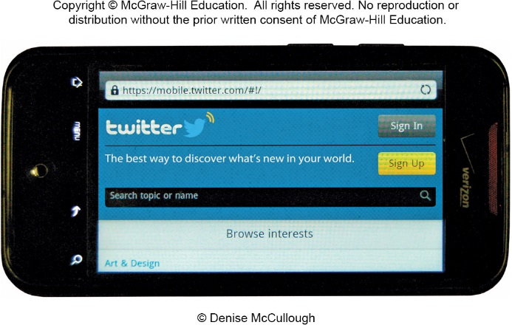
Social Networking
A website where users can create a profile and interact with other users, post information, and engage in other forms of web-based communication
Build relationships with customers
Provide product information
Learn about customer needs
Contact new target markets
Notes:
A social network is a website where users can create a profile and interact with other users, post information, and engage in other forms of web-based communication. Social networks are a valued part of marketing because they are changing the way consumers communicate with each other and with firms. As the number of social network users increases, interactive marketers are finding opportunities to reach out to consumers in new target markets. An important question relates to how social media sites are adding value to the economy. While billions of dollars in investments are being funneled into social media, it may be too early to assess the exact economic contribution of social media to the entire economy.

Slide 18
Types of Consumer-Generated Marketing and Digital Media
Two factors sparked the increase in consumer generated information
Increased tendency of consumers to publish their own thoughts, opinions, reviews, and product discussions through blogs or digital media
Consumers’ tendencies to trust other consumers over corporations. Consumers often rely on the recommendations of friends, family, and fellow consumers when making purchasing decisions.
Notes:
Internet users are creating and reading consumer-generated content as never before and are having a profound effect on marketing in the process. Two factors have sparked the rise of consumer-generated information:
1. The increased tendency of consumers to publish their own thoughts, opinions, reviews, and product discussions through blogs or digital media.
2. Consumers’ tendencies to trust other consumers over corporations. Consumers often rely on the recommendations of friends, family, and fellow consumers when making purchasing decisions.
Marketers who know where online users are likely to express their thoughts and opinions can use these forums to interact with them, address problems, and promote their companies.

Slide 19
Social Networks
Increase in social networking across the world is exponential
It is estimated that adults spend approximately 37 minutes/day on social networking sites
As social networks evolve both marketers and the owners of social networking sites are realizing the opportunities such networks offer
Large reach for the advertiser
Influx of advertising dollars for site owners
Notes:
The increase in social networking across the world is exponential. It is estimated that today’s adults spend approximately 37 minutes per day on social networking sites. As social networks evolve, both marketers and the owners of social networking sites are realizing the opportunities such networks offer—an influx of advertising dollars for site owners and a large reach for the advertiser. As a result, marketers have begun investigating and experimenting with promotion on social networks.

Slide 20
Facebook
Most popular social networking site in the world
Appeals to a broad demographic
Fastest-growing demographic is consumers 55 and over
Encourages consumer interaction with companies and products
Low-cost means of advertising
Useful for the creation of relationships that mutually benefit marketing business & consumer
Notes:
Facebook is the most popular social networking site in the world. Facebook users create profiles, which they can make public or private, and then search the network for people with whom to connect. Many believe Facebook appeals to a broader demographic In fact, the fastest-growing group on Facebook is consumers 55 and over. For this reason, many marketers are turning to Facebook to market products, interact with consumers, and gain free publicity. It is possible for a consumer to become a “fan” of a major company like Starbucks by clicking on the “Like” icon on the coffee retailer’s Facebook page. Facebook is also partnering with businesses to offer unique incentives to businesses. Additionally, social networking sites are useful for relationship marketing, or the creation of relationships that mutually benefit the marketing business and the customer. Companies are utilizing relationship marketing through Facebook to help consumers feel more connected to their products.

Slide 21
Twitter
Hybrid of a social networking site and a micro-blogging site asks: “What is happening?”
Post answers of up to 140 characters, which are then available for their “followers” to read
Nearly half of users visit site on a daily basis—approximately 30% visit the site multiple times/day
More than half of active and monthly users follow companies or brands
Companies use Twitter in conjunction with other social media sites to create unique viral marketing campaigns
Companies using Twitter to gain competitive advantage
Notes:
Twitter is a hybrid of a social networking site and a micro-blogging site that asks users one simple question: “What’s happening?” Members can post answers of up to 140 characters, which are then available for their registered “followers” to read. Nearly half of these users visit the site on a daily basis, while approximately 30 percent visit the site multiple times per day. More than half of Twitter’s active and monthly users follow companies or brands. Like other social networking tools, Twitter is also being used to build, or in some cases rebuild, customer relationships. Other companies are using Twitter in conjunction with other social media sites to create unique viral marketing campaigns. Finally, companies are using Twitter to gain a competitive advantage.

Slide 22
Google+
Social media site intended to rival Facebook and identify users across Google’s various services
CEO Larry Page requires those using Google services to have a Google+ account
Integration between the social network and other services means that users that post are not anonymous
Google+ gives digital marketers an opportunity to capitalize on its growing user base
Does not yet have the same influence as Facebook, marketers are discovering a number of possibilities to engage users with Google+
Notes:
In 2011, Google launched its Google+ network, a social media site intended to rival Facebook and identify users across Google’s various services. CEO Larry Page initiated a move to get more people to use Google+ by requiring those that use Google services, such as Gmail and YouTube, to have a Google+ account. Integration between the social network and its other services means that users who post reviews on different Google platforms can no longer do so anonymously—they are now tied to a person’s Google+ account. Google+ gives digital marketers an opportunity to capitalize on its growing user base. Because Google+ is linked with search results on Google, sharing a firm’s information on Google+ could push the firm up through the ranks of Google search results. Although Google+ does not yet have the same influence as Facebook, marketers are discovering a number of possibilities to engage users with Google+.

Slide 23
Sponsored Content Marketing Videos
One of the best ways to get someone’s attention is to tell a story, and in the digital age it is even more effective to tell that story in a short online video
How-to videos or learning videos give people tips on how to use products as they were intended or in a new way.
Viewer will see a brand logo but the message of the video is not about the brand.
Indirect advertising where the viewer is not seeing the content as promotional.
Companies will get these videos on different online outlets such as BuzzFeed, and they have the potential to go viral.
Notes:
One of the best ways to get someone’s attention is to tell a story, and in the digital age it is even more effective to tell that story in a short online video. These stories can be informational in the form of how-to videos or learning videos that give people tips on how to use products as they were intended or in a new way. Some examples include videos on how to get the best curls with a curling iron or tips on applying makeup. Within the video, the viewer will see a brand logo but the message of the video is not about the brand. The point of these videos is indirect advertising where the viewer is not seeing the content as promotional. Companies will get these videos on different online outlets such as BuzzFeed, and they have the potential to go viral.

Slide 24
Blogs and Wikis
Blogs
A web-based journal in which a writer can editorialize and interact with other Internet users
More than three-fourths of Internet users read blogs
Give consumers power over companies
Wikis
Software that creates an interface which enables users to add to or edit content of some websites
Monitoring relevant wikis gives companies a better idea of how consumers feel about their company or brand
Notes:
Today’s marketers must recognize that the impact of consumer-generated material like blogs and wikis and their significance to online consumers have increased a great deal. Blogs (short for web logs) are web-based journals in which writers can editorialize and interact with other Internet users. More than three-fourths of Internet users read blogs. Blogs give consumers power, sometimes more than companies would like. Bloggers can post whatever they like about a company or its products, whether their opinions are positive or negative, true or false. Rather than trying to eliminate blogs that cast their companies in a negative light, some firms are using their own blogs, or employee blogs, to answer consumer concerns or defend their corporate reputations.
Wikis are websites where users can add to or edit the content of posted articles. One of the best known is Wikipedia, an online encyclopedia with more than 30 million entries in more than 285 languages on nearly every subject imaginable. (Encyclopedia Britannica only has 120,000 entries.) Like all digital media, wikis have advantages and disadvantages for companies. Monitoring relevant wikis can provide companies with a better idea of how consumers feel about the company or brand. There is too much at stake financially for marketers to ignore wikis and blogs. Despite this fact, statistics show that only 34 percent of Fortune 500 companies have a corporate blog.
DID YOU KNOW? Searching is the most popular online activity, while social networking and blogging are fourth.

Slide 25
Video and Photo Sharing
Video Sharing
Allows virtually anybody to upload videos to the Internet
Gives companies the opportunity to upload ads and informational videos about their products
Companies increasingly use consumer-generated content for ads rather than professional ad agencies
Photo Sharing
Allows users to upload, edit, and share photos
Opportunity for companies to market themselves visually by displaying snapshots of company events, staff, and/or products
Notes:
Media sharing sites allow marketers to share photos, videos, and podcasts. Media sharing sites are more limited in scope in how companies interact with consumers. They tend to be more promotional than reactive. This means that while firms can promote their products through videos or photos, they usually do not interact with consumers through personal messages or responses.
Video sharing sites allow virtually anybody to upload videos, from professional marketers at Fortune 500 corporations to the average Internet user. Some of the most popular video sharing sites include YouTube, Vimeo, and Dailymotion. Video sharing sites give companies the opportunity to upload ads and informational videos about their products. Businesses have also begun to utilize consumer-generated video content, saving money they would have spent on hiring advertising firms to develop professional advertising campaigns.
Photo sharing sites allow users to upload and share their photos and short videos with the world. Well-known photo sharing sites include Instagram, Imgur, Shutterly, Photobucket, and Flickr. Other sites are emerging that take photo sharing to a new level. Pinterest is a photo sharing bulletin board site that combines photo sharing with elements of bookmarking and social networking. Photo sharing represents an opportunity for companies to market themselves
visually by displaying snapshots of company events, company staff, and/or company products.

Slide 26
Viral Marketing and Podcasts
Viral Marketing
A marketing tool that uses the Internet, particularly social networking and video sharing sites, to spread a message and create brand awareness
Podcasts
An audio or video file that can be downloaded from the Internet with a subscription that automatically delivers new content to listening devices or personal computers
Good marketing tool for reaching the 18-34 demographic
Convenient, offer users the ability to listen to or view content when and where they choose
Notes:
Viral marketing occurs when a message gets sent from person to person to person. It can be an extremely effective tool for marketers—particularly on the Internet, where one click can send a message to dozens or hundreds of people simultaneously. Marketers are taking advantage of the viral nature of video sharing sites like YouTube, either by creating their own unique videos or advertising on videos that have already reached viral status.
Podcasts are audio or video fi les that can be downloaded from the Internet via a subscription that automatically delivers new content to listening devices or personal computers. Podcasting offers the benefit of convenience, giving users the ability to listen to or view content when and where they choose. It is estimated that approximately 39 million U.S. consumers download podcasts every month. The markets podcasts reach are ideal for marketers, especially the 18–34 demographic, which includes the young and the affluent. Many companies hope to use podcasts to create brand awareness, promote their products, and encourage customer loyalty.

Slide 27
Virtual Worlds
Games and programs allowing viewers to develop avatars that exist in an online virtual world
Social networks with a twist
Many virtual worlds allow users to buy and sell goods, services, and even real estate—all while spending real money
Real-world marketers have been eager to capitalize on the popularity of virtual gaming sites
MediaSpike
Firms looking toward virtual worlds to familiarize consumers with their goods and services
Notes:
Games and programs allowing viewers to develop avatars that exist in an online virtual world have exploded in popularity in the 21st century. Virtual worlds include Second Life, Everquest, Sim City, and the role-playing game World of Warcraft. These sites can be described as social networks with a twist. Virtual realities are three- dimensional, user-created worlds that have their own currencies, lands, and residents that come in every shape and size. Real-world marketers and organizations have been eager to capitalize on the popularity of virtual gaming sites. MediaSpike specializes in placing brands into mobile games. Other businesses are looking toward virtual worlds to familiarize consumers with their goods and services.

Slide 28
Mobile Marketing
Consumers increasingly do their business and shopping from mobile devices and smartphones
Can act as airline boarding passes, GPS devices, and even hotel room keys
Brands must recognize importance of mobile marketing
Marketers spent $31.45 billion in 2014
E-commerce sales on smart phones is estimated to reach $638 billion by 2018
Makes it essential for companies to understand how to use mobile tools to create effective campaigns
Notes:
As digital marketing becomes increasingly sophisticated, consumers are beginning to utilize mobile devices like smartphones as a highly functional communication method. In industries such as hotels, airlines, and car rental agencies, mobile phones have become a primary method for booking reservations and communicating about services. They can act as airline boarding passes, GPS devices, and even hotel room keys. Other marketing uses of mobile phones include sending shoppers timely messages related to discounts and shopping opportunities.
Mobile marketing is exploding—marketers are estimated to spend $31.45 billion on mobile marketing in 2014. To avoid being left behind, brands must recognize the importance of mobile marketing. E-commerce sales on smartphones is also rapidly growing. Sales are estimated to reach $638 billion by 2018. This makes it essential for companies to understand how to use mobile tools to create effective campaigns.

Slide 29
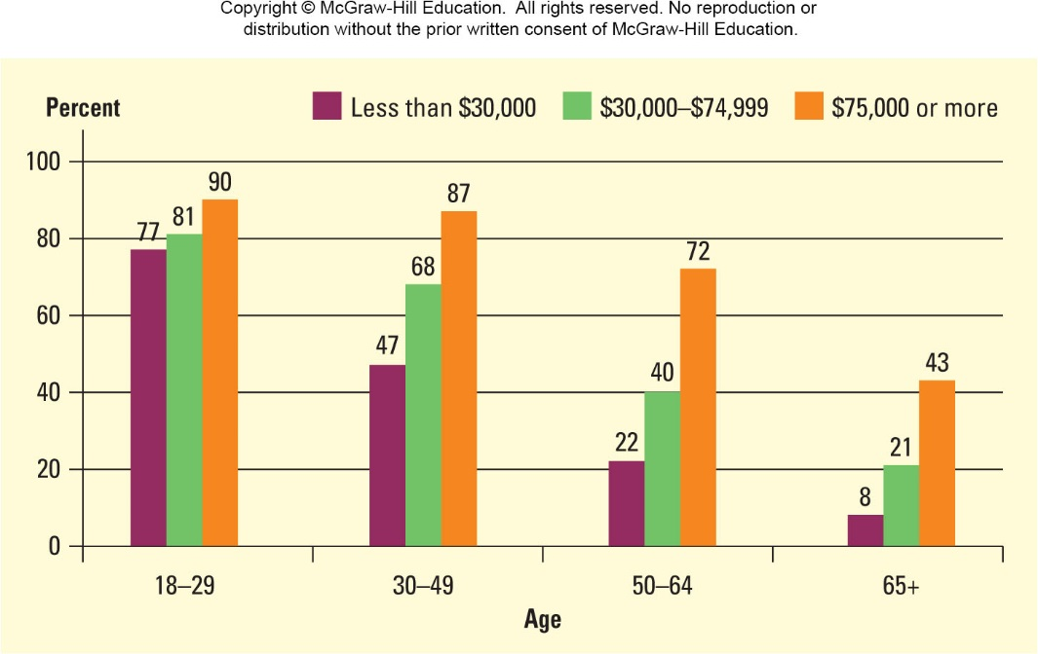
Smartphone Ownership by Age and Income
Notes:
The figure on this slide breaks down smartphone usage by age and income.

Slide 30
Common Mobile Marketing Tools (1 of 2)
SMS Messages
Text messages of 160 words or less
An effective way to send coupons to prospective customers
Multimedia messages
Allows companies to send video, audio, photos, and other types of media over mobile devices
Mobile advertisements
Visual advertisements that appear on mobile devices
Companies might choose to advertise through search engines, websites, or even games accessed on mobile devices
Marketers spend ~$3 billion on mobile advertising
Notes:
Some of the more common mobile marketing tools include the following:
SMS messages: SMS messages are text messages of 160 words or less. SMS messages have been an effective way to send coupons to prospective customers.
Multimedia messages: Multimedia messaging takes SMS messaging a step further by allowing companies to send video, audio, photos, and other types of media over mobile devices. Gap used Instagram Direct as the outlet for their “What I Wore Today (#WIWT)” campaign, allowing users to win a Gap denim tablet case.
Mobile advertisements: Mobile advertisements are visual advertisements that appear on mobile devices. Companies might choose to advertise through search engines, websites, or even games accessed on mobile devices. Marketers spend approximately $3 billion on mobile advertising.

Slide 31
Common Mobile Marketing Tools (2 of 2)
Mobile websites
Websites designed for mobile devices
Mobile devices constitute one-third of web traffic
Location-based networks
Built for mobile devices
Foursquare lets users check in and share location with others
Mobile applications (apps)
Software programs that run on mobile devices and give users access to certain content
Businesses release apps to help consumers access more information about their company or to provide incentives
Notes:
Continuing the list of common mobile marketing tools:
Mobile websites: Mobile websites are websites designed for mobile devices. Mobile devices constitute one-third of web traffic.
Location-based networks: Location-based networks are built for mobile devices. One of the most popular location-based networks is Foursquare, which lets users check in and share their location with others. Foursquare partnered with Visa and MasterCard to offer discounts at participating retailers, including Dunkin’ Donuts and Burger King.
Mobile applications: Mobile applications (known as apps) are software programs that run on mobile devices and give users access to certain content. Businesses release apps to help consumers access more information about their company or to provide incentives. Apps are discussed in further detail on the next slide.

Slide 32
Applications (Apps)
Apps adding new layer to the marketing environment
Approximately half of all American adult cell phone users have applications on their mobile devices
Convenience and cost savings to the consumer
Companies are beginning to use mobile marketing to offer additional incentives to customers
As of 2014, ~58% of American adults have smartphones
QR scanning app
Black-and-white squares can be scanned for hidden link, video, or image on the smartphone screen
Notes:
Applications are adding an entirely new layer to the marketing environment, as approximately half of all American adult cell phone users have applications on their mobile devices. The most important feature of apps is the convenience and cost savings they offer to the consumer. As of 2014, an estimated 58 percent of American adults have smartphones, so businesses cannot afford to miss out on the chance to profit from these new trends. To remain competitive, companies are beginning to use mobile marketing to offer additional incentives to consumers.
Another application that marketers are finding useful is the QR scanning app. QR codes are black-and-white squares that sometimes appear in magazines, posters, and storefront displays. Smartphone users who have downloaded the QR scanning application can open their smartphones and scan the code, which contains a hidden message accessible with the app. The QR scanning app recognizes the code and opens the link, video, or image on the phone’s screen. Marketers are using QR codes to promote their companies and offer consumer discounts.

Slide 33
Bitcoin
Virtual peer-to-peer currency can be used to make a payment via smartphone
Increasingly accepted, Germany has recognized it as a unit of account
Fluctuates in value so risky for firms to hold onto
Legal issues due to state money-transmission laws
Not backed by a central bank and software is run on a network of volunteers’ computers
Recent scandal: MtGox (a Bitcoin exchange) lost Bitcoins amounting to $620 million in value
Notes:
Bitcoin is a virtual peer-to-peer currency that can be used to make a payment via smartphone. Smaller organizations have begun to accept bitcoin at some of their stores. Virtual currency exchanges have run into legal issues, however, due to state money-transmission laws. Bitcoin also fluctuates in value, making it risky for companies to hold onto the virtual currency for long periods. It is not backed by a central bank and its software is run on a network of volunteers’ computers. Bitcoin is being increasingly accepted among officials, and Germany has recognized it as a unit of account. However, a recent scandal has caused some to question Bitcoin’s use. MtGox, a bitcoin exchange, reportedly lost hundreds of thousands of bitcoins amounting to $620 million in value. A lawsuit has been filed, and MtGox declared bankruptcy.

Slide 34
Widgets
Small bits of software on a website, desktop, or mobile device that perform a simple purpose such as stock quotes or blog updates
Have been used as a form of viral marketing
Users can download the widget and send it to their friends with a click of the button
Can update the user on the latest company or product information, enhancing relationship marketing between firms and their fans
Notes:
Widgets are small bits of software on a website, desktop, or mobile device that perform a simple purpose, such as providing stock quotes or blog updates. Marketers might use widgets to display news headlines, clocks, or games on their web pages. Widgets have been used by companies such as A&E Television Network as a form of viral marketing—users can download the widget and send it to their friends with a click of a button. Widgets are an innovative digital marketing tool to personalize web pages, alert users to the latest company information, and spread awareness of the company’s products.

Slide 35
Using Digital Media to Reach Consumers
Customer-generated communications and digital media take some of professional marketer’s power to control and dispense information and place it in hands of consumers
Marketers can use digital media to get better and more targeted information about the consumer
Essential that marketers focus on:
The changing social behaviors of consumers
The ways in which they gather and use information
The way the Internet is enabling them to get involved in the marketing process
As in traditional marketing efforts, marketers need to know their target market
Notes:
We’ve seen that customer-generated communications and digital media connect consumers as never before. In many ways, these media take some of the professional marketer’s power to control and dispense information and place it in the hands of the consumer. However, this shift does not have to spell doom for marketers, who can choose to utilize the power of the consumer and Internet technology to their advantage. While consumers use digital media to access more product information, marketers can use the same sites to get better and more targeted information about the consumer—often more than they could gather through traditional marketing venues. Marketers increasingly use consumer-generated content to aid their own marketing efforts, even going so far as to incorporate Internet bloggers in their publicity campaigns. Finally, marketers are also beginning to use the Internet to track the success of their online marketing campaigns, creating an entirely new way of gathering marketing research. The challenge for digital media marketers is to constantly adapt to new technologies and changing consumer patterns. Unfortunately, the attrition rate for digital media channels is very high, with some dying off each year as new ones emerge. As in traditional marketing efforts, they need to know their target market.

Slide 36
Social Technographics (1 of 2)
Creators
Consumers who create their own media outlets
Blogs, podcasts, consumer-generated videos & Wikis
Conversationalists
Regularly update their Twitter feeds or status updates on social networking sites
Critics
People who comment on blogs or post ratings and reviews on review websites (Yelp)
Collectors
Collect information and organize content generated by critics and creators
Notes:
Creators are consumers who create their own media outlets, such as blogs, podcasts, consumer-generated videos, and wikis. Consumer-generated media are increasingly important to online marketers as a conduit for addressing consumers directly. The second group of Internet users is conversationalists. Conversationalists regularly update their Twitter feeds or status updates on social networking sites. Although they are less involved than creators, conversationalists spend time at least once a week (and often more) on digital media sites posting updates.83 The third category, critics, consists of people who comment on blogs or post ratings and reviews on review websites such as Yelp. Because many online shoppers read ratings and reviews to aid their purchasing decisions, critics should be a primary component in a company’s digital marketing strategy. The next category is collectors. They collect information and organize content generated by critics and creators. Because collectors are active members of the online community, a company story or site that catches the eye of a collector is likely to be posted, discussed on collector sites, and made available to other online users looking for information.

Slide 37
Social Technographics (2 of 2)
Joiners
Include all who become users of Twitter, Facebook, or other social networking sites
Spectators
Read online information but do not join groups or post anywhere, are the largest group in most countries
Inactives
Online users who do not participate in any digital online media, their numbers are dwindling
Notes:
Joiners include all who become users of Twitter, Facebook, or other social networking sites. It is not unusual for consumers to be members of several social networking sites at once. Joiners use these sites to connect and network with other users, but as we’ve seen, marketers too can take significant advantage of these sites to connect with
consumers and form customer relationships. The last two segments are Spectators and Inactives. Spectators, who read online information but do not join groups or post anywhere, are the largest group in most countries. Inactives are online users who do not participate in any digital online media, but their numbers are dwindling.
Marketers need to consider what proportion of online consumers are creating, conversing, rating, collecting, joining, or simply reading online materials.

Slide 38
Marketing Research and Information Systems
Digital media and social networking sites can help
Gather data on consumers and their preferences
Twitter and Facebook can be good substitutes for focus groups
Online surveys can serve as an alternative to mail, telephone, or personal interview
Crowdsourcing
Describes how marketers use digital media to find out the opinions or needs of the crowd (or potential markets)
Lets companies gather and utilize consumers’ ideas in an interactive way when creating new products
Notes:
Marketing research and information systems can use digital media and social networking sites to gather useful information about consumers and their preferences. Sites such as Twitter and Facebook can be good substitutes for focus groups. Online surveys can serve as an alternative to mail, telephone, or personal interviews. Crowdsourcing describes how marketers use digital media to find out the opinions or needs of the crowd (or potential markets). Crowdsourcing lets companies gather and utilize consumers’ ideas in an interactive way when creating new products.

Slide 39

Consumer Feedback
Important part of the digital equation
Ratings and reviews have become exceptionally popular
Online reviews influence buying decisions of ~90% of U.S. consumers
Most online shoppers search the Internet for ratings and reviews before making major purchase decisions
Many companies do not yet take full advantage of digital tools
Notes:
Consumer feedback is an important part of the digital media equation. Ratings and reviews have become exceptionally popular; Online reviews are estimated to influence the buying decisions of approximately 90 percent of U.S. consumers. Today, most online shoppers search the Internet for ratings and reviews before making major purchase decisions. While consumer-generated content about a firm can be either positive or negative, digital media forums do allow businesses to closely monitor what their customers are saying. Yet despite the ease and obvious importance of online feedback, many companies do not yet take full advantage of the digital tools at their disposal.

Slide 40
Legal and Social Issues in Internet Marketing
Extraordinary growth of information technology, the Internet, and social networks has generated many legal and social issues for consumers and businesses
Privacy concerns
Risk of identity theft
Risk of online fraud
Need to protect intellectual property
U.S. Federal Trade Commission (FTC) compiles an annual list of consumer complaints related to the Internet and digital media
Notes:
The extraordinary growth of information technology, the Internet, and social networks has generated many legal and social issues for consumers and businesses. These issues include privacy concerns, the risk of identity theft and online fraud, and the need to protect intellectual property. The U.S. Federal Trade Commission (FTC) compiles an annual list of consumer complaints related to the Internet and digital media. We discuss these in the next several slides, as well as steps that individuals, companies, and the government have taken to address them.

Slide 41
Privacy
Current technology has made it possible for marketers to amass vast quantities of personal information, often without consumers’ knowledge, and to share and sell this information to interested third parties
Cookies -- where companies offer to collect personal information from social networking sites and other forums
Laws and regulations have difficulty keeping up with the rapidly-changing Internet
Federal Trade Commission considering creating legislation that limits information companies can gather online
An online privacy “Bill of Rights” to protect consumers
Notes:
The unprecedented growth in information technology and the Internet has created legal and social issues that heretofore were unknown. These challenges typically fall in one or more of the categories of privacy, identity theft, and intellectual property. Privacy concerns are probably the most urgent of the legal and social issues today. Consumer surfing and purchasing behavior is often tracked on the Internet through the use of “cookies” that store data on customers. Another Internet privacy issue occurring more frequently is “scraping,” an activity where companies offer to collect personal information from social networking sites and other forums. Since Internet privacy issues have become such a problem, regulators are proposing bills to address the issue.
Due to consumer concerns over privacy, the Federal Trade Commission (FTC) is considering developing regulations that would better protect consumer privacy by limiting the amount of consumer information that businesses can gather online. Other countries are pursuing similar actions. In the United States, one proposed solution for consumer Internet privacy is a “do not track” bill, similar to the “do not call” bill for telephones, to allow users to opt out of having their information tracked.

Slide 42
Identity Theft
When criminals obtain personal information that allows them to impersonate someone else in order to use their credit to access financial accounts and make purchases
Security breaches are a serious threat
Phishing is using a counterfeit of a familiar website to deceive people into divulging private information
To deter identity theft, the National Fraud Center wants financial institutions to implement new technologies such as digital certificates, digital signatures, and biometrics
Notes:
An area that has recently become a major source of concern is identity theft. This occurs when criminals obtain personal information that allows them to impersonate someone else in order to use their credit to obtain financial accounts and make purchases. The most common complaints relate to credit card fraud, bank fraud, and loan fraud. One growing scam used to initiate identity theft fraud is the practice of phishing, whereby con artists counterfeit a well-known website and send out e-mails directing victims to it. There visitors find instructions to reveal sensitive information such as their credit card numbers. The National Fraud Center wants financial institutions to implement new technologies such as digital certificates, digital signatures, and biometrics to decrease identity theft.

Slide 43
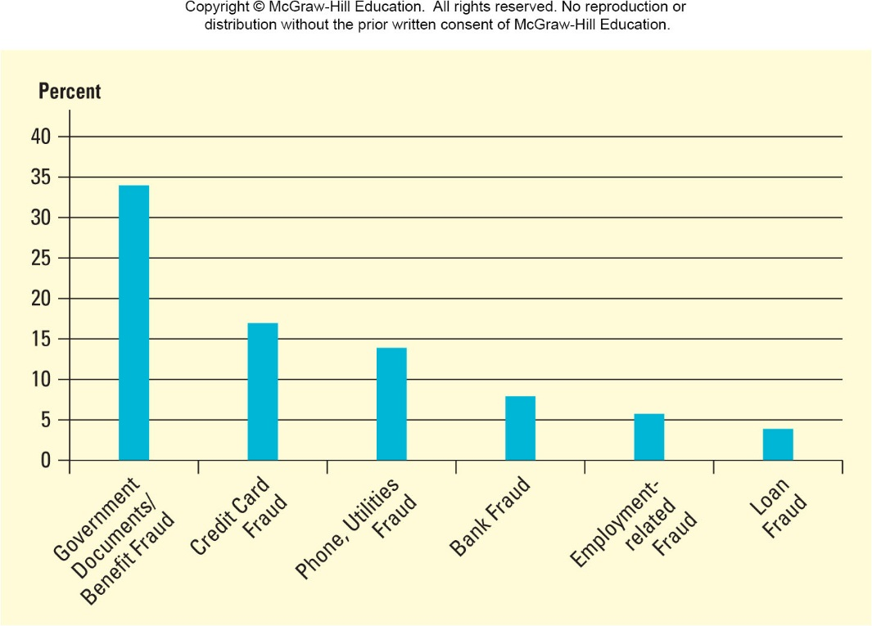
Main Sources of Identity Theft
Notes:
The figure on this slide displays the most common complaints relate to government documents/benefits fraud, followed by credit card fraud, utility fraud, bank fraud, employment fraud, and loan fraud.

Slide 44
Online Fraud
Any attempt to conduct fraudulent activities online
Cybercriminals increasingly using social networking sites and other digital media to commit fraud
Facebook and Twitter
Twitter has experienced an influx of fake Twitter accounts to try and boost publicity
Social networking sites to pose as charitable institutions or victims of natural disasters
Privacy advocates advise to avoid giving out personal information
Notes:
Online fraud includes any attempt to conduct fraudulent activities online, such as by deceiving consumers into releasing personal information. It is becoming a major source of frustration among users of social networking sites, because cybercriminals are finding new ways to use sites like Facebook and Twitter to commit fraudulent activities. Twitter has experienced an influx of fake Twitter accounts to try to boost publicity. A celebrity, for instance, might pay somebody to rebroadcast their tweets on a number of fake Twitter accounts. It is estimated that between 5 and 9 percent of Twitter accounts could be fake. Perhaps the most disturbing is the practice of using social networking sites to pose as charitable institutions or victims of natural disasters. Privacy advocates advise that the best way to stay out of trouble is to avoid giving out personal information, such as Social Security numbers or credit card information, unless the site is definitely legitimate.

Slide 45
Intellectual Property
Intellectual property can include songs, movies, books, and software
Such intellectual property consists of the ideas and creative materials developed to solve problems, carry out applications, and educate and entertain others
Generally protected by patents and copyrights, but these can be difficult to enforce globally
Piracy and illegal sharing costs global industries billions annually
90% of illegal software copying is done by businesses
Notes:
Internet users and others want to protect their rights to property they may create, including songs, movies, books, and software. Such intellectual property consists of the ideas and creative materials developed to solve problems, carry out applications, and educate and entertain others. Although intellectual property is generally protected by patents and copyrights, each year losses from the illegal copying of computer programs, music, movies, compact discs, and books reaches billions of dollars in the United States alone. The software industry loses more than $63 billion globally each year due to theft and illegal use of software products, according to the Business Software Alliance. About 90 percent of illegal software copying is actually done by businesses

Slide 46
Illegal Sharing of Content
Consumers rationalize the pirating of software, movies, videogames, and music for a number of reasons
Don’t have the money to pay for what they want
Because their friends engage in piracy
Others enjoy the thrill of getting away with something with low risk consequences
Being tech-savvy allows them to pirate content
Notes:
Illegal sharing of content is another major intellectual property problem. Consumers rationalize the pirating of software, videogames, movies, and music for a number of reasons. First, many feel they just don’t have the money to pay for what they want. Second, because their friends engage in piracy and swap digital content, some users feel influenced to engage in this activity. Others enjoy the thrill of getting away with something with a low risk of consequences. And finally, some people feel being tech-savvy allows them to take advantage of the opportunity to pirate content.

Slide 47
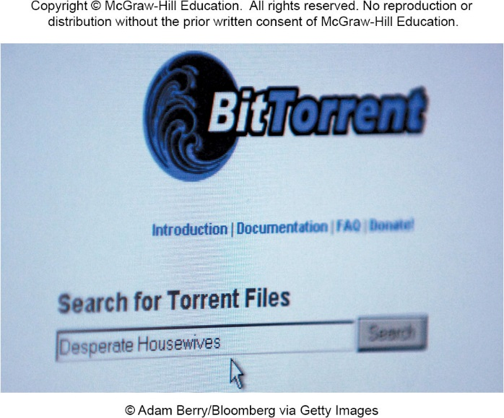
BitTorrent
The file-sharing protocol BitTorrent allows users to share and download Files
The U.S. Copyright Group obtained the IP addresses of users who downloaded specific movies using BitTorrent technology
Taking action against thousands of BitTorrent users for illegally downloading protected content
Notes:
The file-sharing protocol BitTorrent allows users to share and download Files
The U.S. Copyright Group obtained the IP addresses of users who downloaded specific movies using BitTorrent technology
Taking action against thousands of BitTorrent users for illegally downloading protected content

Slide 48
Digital Media’s Impact on Marketing
Digital media can make your company more efficient and productive
Transition to digital media can be challenging
New media may require employees with new skills or additional training for current employees
Correct blend of traditional and digital media in marketing mix takes time and consideration
Future marketing opportunities will require a knowledge of digital media and how to use them
Notes:
As we have pointed out in this chapter, digital media is having a major effect on the business world. Developing a strategic understanding of how digital marketing can make business more efficient and productive is increasingly necessary. Traditional businesses accustomed to using print media can find the transition to digital challenging. New media may require employees with new skills or additional training for current employees. Determining the correct blend of traditional and new media requires careful consideration; the mix will vary depending on the business, its size, and its target market. Future career opportunities will require skills in both traditional and digital media areas so that marketers properly understand and implement marketing strategies that help businesses achieve a competitive advantage.

Slide 49
Solve the Dilemma (1 of 3) Developing Successful Freeware
Paul Easterwood, a graduate of Colorado State University with a degree in computer science, entered the job market during a slow point in the economy
Only offer he received -- Pentaverate Inc., freeware
Freeware, or public domain software, is offered to consumers free of charge in exchange for revenue generated later
Paul did research and learned from an article the enormous potential of freeware
Job would be to develop freeware that people could download and would generate significant income for firm
With no experience in marketing, Paul was at a loss what software would make money for the company
Notes:
This Solve the Dilemma is taken from Chapter 13, page 416:
Paul Easterwood, a recent graduate of Colorado State University with a degree in computer science, entered the job market during a slow point in the economy. Tech sector positions were hard to come by, and Paul felt he wouldn’t be making anywhere near what he was worth. The only offer he received was from an entrepreneurial firm, Pentaverate Inc., that produced freeware. Freeware, or public domain software, is offered to consumers free of charge in exchange for revenues generated later. Makers of freeware (such as Adobe and Netscape) can earn high profits through advertisements their sites carry, from purchases made on the freeware site, or, for more specialized software, through fee-based tutorials and workshops offered to help end users. Paul did some research and found an article in Worth magazine documenting the enormous success of freeware.
Pentaverate Inc. offered compensation mainly in the form of stock options, which had the potential to be highly profitable if the company did well. Paul’s job would be to develop freeware that people could download from the Internet and that would generate significant income for Pentaverate. With this in mind, he decided to accept the position, but he quickly realized he knew very little about business. With no real experience in marketing, Paul was at a loss to know what software he should produce that would make the company money.

Slide 50
Solve the Dilemma (2 of 3) Developing Successful Freeware
Paul’s first project IOWatch
Virtual tour of outer space, images and video downloaded to PC
Experienced little use and drew little advertising income
Paul hired consultant to figure out what people want to design a better second project
Needed to know what went wrong with IOWatch
Notes:
His first project, IOWatch, was designed to take users on virtual tours of outer space, especially the moons of Jupiter (Paul’s favorite subject), by continually searching the Internet for images and video clips associated with the cosmos and downloading them directly to a PC. The images would then appear as soon as the person logged on. Advertisements would accompany each download, generating income for Pentaverate.
However, IOWatch experienced low end-user interest and drew little advertising income as a result. Historically at Pentaverate, employees were fi red after two failed projects. Desperate to save his job, Paul decided to hire a consultant. He needed to figure out what customers might want so he could design some useful freeware for his second project. He also needed to know what went wrong with IOWatch, because he loved the software and couldn’t figure out why it had failed to find an audience. The job market has not improved, so Paul realizes how important it is for his second project to succeed.

Slide 51
Solve the Dilemma (3 of 3) Developing Successful Freeware
Discussion Questions
As a consultant, what would you do to help Paul figure out what went wrong with IOWatch?
What ideas for new freeware can you give Paul? What potential uses will the new software have?
How will it make money?
Notes:
Discussion Questions
1. As a consultant, what would you do to help Paul figure out what went wrong with IOWatch?
2. What ideas for new freeware can you give Paul? What potential uses will the new software have?
3. How will it make money?

Slide 52
Discussion
Define accessibility, addressability, connectivity, interactivity, and control. What do these terms have to do with digital marketing?
How is the Internet changing the practice of marketing?
What impact do digital media have on the marketing mix?
Why do creators want to protect their intellectual property? Provide an example on the Internet where intellectual property may not be protected or where a copyright has been infringed.
Notes:
Define accessibility, addressability, connectivity, interactivity, and control. What do these terms have to do with digital marketing?
Accessibility, addressability, connectivity, control, and interactivity are the five characteristics of digital media that differentiate them from traditional marketing media (see Table 13.1). Accessibility allows consumers to find information about competing products, prices, and reviews and become more informed about a firm and the relative value of its products. Addressability is the ability of a business to identify customers before they make purchases. Connectivity is the use of digital networks to provide linkages between information providers and users. Interactivity allows customers to express their needs and wants directly to the firm in response to its
How is the Internet changing the practice of marketing?
There are many correct responses to this question, as it is very open-ended. The Internet has increased the speed of communications, has made marketing a more interactive practice between marketers and consumers, and has given consumers a voice and therefore more power to either criticize or praise products and services. The Internet has taken away some power from established marketing firms, even allowing fans in some instances to create popular advertising campaigns and ads. However, it has also allowed marketers to improve their market research efforts and to broaden their reach into new target markets. In some ways, the Internet has leveled the playing field and has provided small businesses with opportunities that they did not have before.
What impact do digital media have on the marketing mix?
Digital media change how marketers should approach the marketing mix somewhat, but the marketing mix remains as essential as ever. There are a few key differences when using digital media in the marketing mix. First, digital media make customer communications richer, faster, and interactive. Second, digital media help companies reach new target markets more easily, affordably, and quickly than ever before. Finally, digital media help marketers utilize new resources in seeking out and communicating with customers. One of the most important benefits of digital marketing is the ability of marketers and customers to easily share information.
Why do creators want to protect their intellectual property? Provide an example on the Internet where intellectual property may not be protected or where a copyright has been infringed.
Intellectual property is important for creators because it is a source of competitive advantage and revenues. If innovations are not protected by IP laws, then competitors will take away market share and profits from the organization or individual that invested all the time and money into research and development. Without intellectual property protection, there is little incentive to engage in researching and innovating because it is a risky, time-consuming, and expensive endeavor with little reward. Students’ examples will vary.

